Slide 1
Fe-OM associations may act as a mechanism for DOC mobilization in coastal upland forest
Advisor: Allison Myers-Pigg
Connor O’Loughlin
DOE SULI Intern
Notes:
Image: Sequim Bay

Slide 2
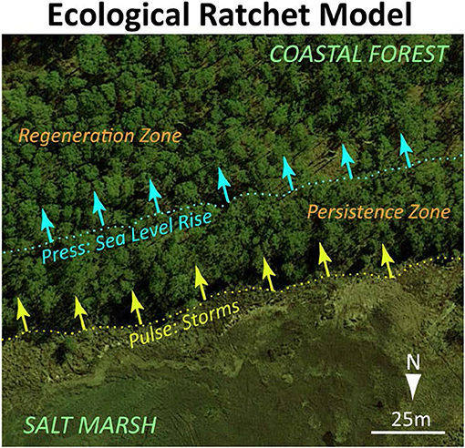
Saltwater: Bane of Coastal Forest
Climate change is linked to an increase in…
Frequency and intensity of storms
Annual precipitation and temperature
Sea levels
Inundation of seawater can threaten upland forests
How will this impact biogeochemical processes?
S. Fagherazzi, S. Anisfeld, L. Blum, E. Long, R. Feagin, A. Fernandes, W. Kearney, and K. Williams, “Frontiers | Sea Level Rise and the Dynamics of the Marsh-Upland Boundary,” Frontiers, (2019).
Notes:
Species are not salt tolerant
Soil is (typically) well drained and not waterlogged
Changes in redox state
Nutrient leeching
Mineral-OM interaction/associations

Slide 3
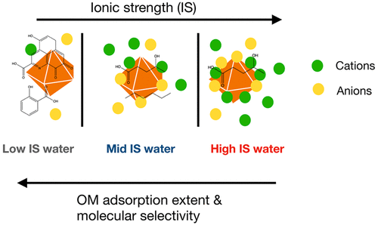


Ionic Strength may impact OM release through exchange of ions
Ionic Strength
(Tomaszewski et al., 2021)
Notes:
Ionic strength of solution seems to influence the release dissolved organic carbon (DOC)
Through steric hinderance or taking all the available binding sites
DOC release will not happen right away but experience a lag as ions compete with binding sites
The release of OM then subjects it to either lateral movement or consumption by microbes. Affecting the OM available in the system.

Slide 4
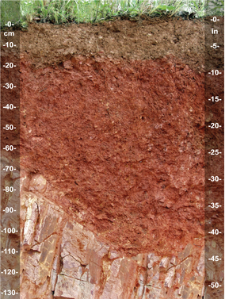
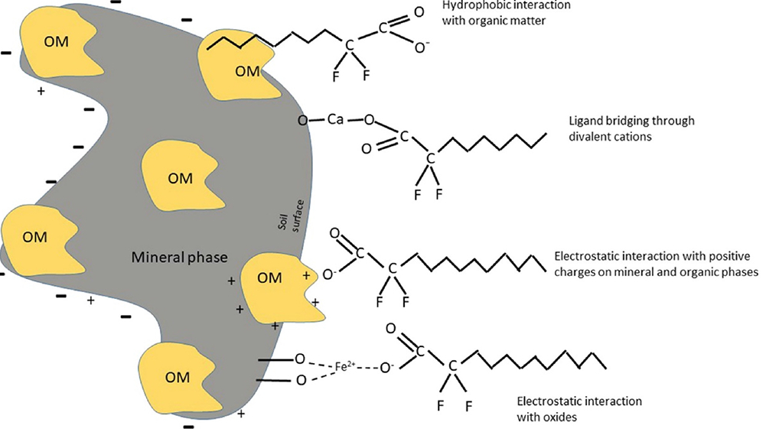
Mineral-Organic Matter (e.g. Fe-OM) interactions may also drive OM release
Mineral-OM Interactions
(Bolan et al., 2021)
Notes:
Factors affecting mineral-OM relationships
Cation exchange (the type of cations present)
Type of mineral (Fe, Al, Cu) and valence state
OM ligand denticity
Fe plays a key role in biogeochemical cycling
Salinity has been shown to be a factor in Fe-OM aggregation
Studies have found that humic substances may be a carrier for Fe from boreal riparian environments to marine systems

Slide 5
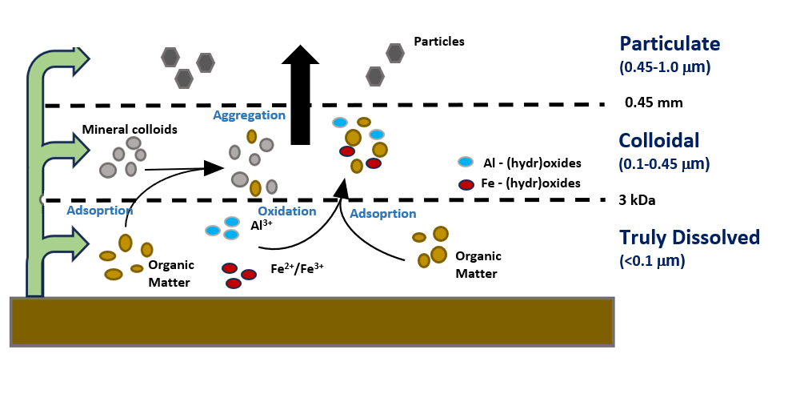
Is Bigger Better when it comes to particle size and DOC mobilization?
Notes:
Talk about size fraction
Truly dissolved: <0.1
Colloidal 0.1-0.45
Particulate 0.45-1.0
Interested to see which size fraction contains bulk of Fe and OC.
Fe-OM material seems to be aggregating due to oxidation and absorption s coupled with the reabsorption of OM to minerals following a decrease in the ionic strength of the solution leading to a larger portion being in the colloidal and particulate phase.

Slide 6

Big Question
After saltwater inundation, does Fe-OM interactions provide a mechanism for colloidal OC mobilization?

Slide 7
Hypotheses
Changes in ionic strength with subsequent DI washes will result in differences in DOC mobilization
Oxygenated systems will release more DOC due to OM adsorption to Fe(III).
Fe(III) will be associated with aromatic DOM across all size fractions.

Slide 8
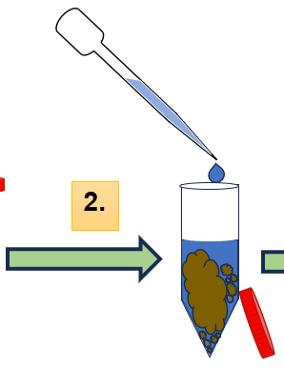

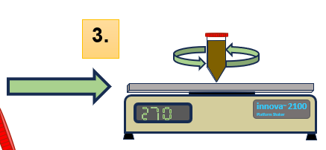



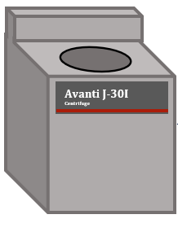

Sampling
Prepared in triplicate
5 washes
1 /w 25% Artificial seawater (ASW)
4 /w DI water
3 Size Fractions (μm)
<0.1
0.1-0.45
0.45-1.0
2 Treatments
Oxic
Anoxic
Soil
5 g field moist soil
72 hr anoxic treatment
Wash added
35 mL of 25% ASW
Anoxic samples were in glove box
Experimental Design
Shaker Table
Shaken for 24 hrs
270 RPM
Wash added
Step 2 is repeated but with DI water
4x times
CDOM
ICP-MS
O₂%
Used a Firesting GO2 probe
Set to room temp (20°C)
Fe Assay
TOC
Centrifugation
Fractions are centrifuged at prescribed time and speed
Notes:
Do not forget to mention that we used a ferrozine assay to determine Fe in the samples

Slide 9
Organic Carbon release was greatest in wash 3 and in the 0.45-1.0 µm fraction
Saltwater wash
Notes:
DOC peak at wash 3!
The most DOC was released in the 0.45-1.0 fraction size

Slide 10
Ionic strength is not responsible for all the variation

Slide 11
No major differences in DOC release or Fe between aerobic and anerobic treatments
Saltwater wash
Saltwater wash

Slide 12
Fe(III) and DOC are releasing at the same time
Saltwater wash

Slide 13
The increase in aromatic DOM may be related to shifts in Fe redox states
There is a significant relationship between Fe(III) and the aromaticity of DOM across all size fractions
Increasing aromaticity

Slide 14
Conclusions
Peak DOC release was in the 0.45-1.0 μm fraction and experienced a lag period
No difference in the DOC between anoxic and oxic treatments
There is slightly positive relationship between aromaticity of OM and Fe (III)
Fe-OM interactions offer a mechanism for DOC mobilization in coastal upland forest

Slide 15

Conclusions
Changes in ionic strength with subsequent DI washes will result in differences in DOC mobilization
Oxygenated systems will release more DOC due to OM adsorption to Fe(III).
Fe(III) will be associated with aromatic DOM across all size fractions.
Fe-OM interactions offer a mechanism for DOC mobilization in coastal upland forest

Slide 17
Acknowledgements
Allison Myers-Pigg – Mentor
Nick Ward – Co mentor
Kaizad Patel – Collaborator
Edward O’Loughlin – Collaborator
Alan Roebuck - Collaborator
Nicole C. Castilleja Bentley – SULI Coordinator
This work was supported in part by the U.S Department of Energy, Office of Science, Office of Workforce Development for Teachers and Scientists (WDTS) under the Science Undergraduate Laboratory Internship Program (SULI).

